Slide 1
STATISTICS IN DATA ANALYST
Presented by,
B. Tanuja Lakshmi
Batch:2021-6313

Slide 2
CONTENT
Statistics
Types of data in statistics
Types of statistics
Variable scales
Hypothesis testing
Types of hypothesis testing
Steps of hypothesis testing

Slide 3
STATISTICS
Consists of a body of methods for collecting and analysing the data.
It provides methods for
Design: Planning and carrying out the research studies
Description: Summarizing and exploring the data
Inference: Making predictions and generalising the data

Slide 4
TYPES OF DATA
There are two types of data in statistics
Qualitative data
It is non-numerical data.
Eg: the texture of the skin, the colour of the eyes, etc
Quantitative data
Quantitative data is given in numbers. Data in the form of questions such as “how much”, “how many”, gives the quantitative data.

Slide 5
TYPES OF STATISTICS
2 major types of statistics
Descriptive statistics
It consists of methods of summarizing the data from a sample using indexes such as mean or standard deviation.
It includes graphs, charts, tables.
Inferential statistics
It is used for interpreting the meaning of the descriptive statistics.
It draw the conclusions from data that are subject to random variables.
It includes hypothesis testing, sampling variation.

Slide 6
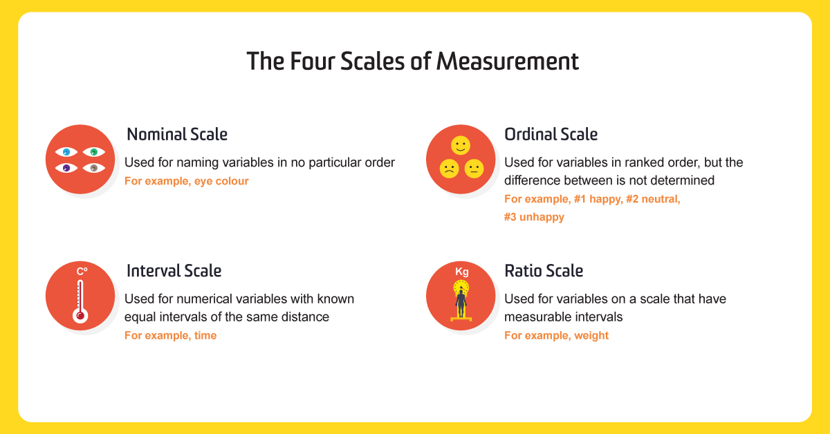
VARIABLES SCALES
Variable can also described according to the scale on which they are defined.
There are four different scales of measurement. The data can be defined as being one of the four scales.

Slide 7
HYPOTHESIS TESTING
Hypothesis testing is a form of statistical inference that uses data from a sample to draw conclusions about a population parameter or a population probability distribution.
First, a tentative assumption is made about the parameter or distribution. This assumption is called the null hypothesis and is denoted by H₀.
It is a way of statistically testing a hypothesis by comparing the data values, thst is called significance test.
Hypothesis are formulated before collecting the data.

Slide 8
TYPES OF HYPOTHESIS
It consists of two hypothesis
NULL HYPOTHESIS H₀
The assumption of a statistical test is called the null hypothesis, or hypothesis 0 (H0 for short).
It is often called the default assumption, or the assumption that nothing has changed.
ALTERNATIVE HYPOTHESIS H₁
A violation of the test’s assumption is often called the first hypothesis, hypothesis 1 or H1 for short.
H1 is really a short hand for “some other hypothesis,” as all we know is that the evidence suggests that the H0 can be rejected.

Slide 9
STEPS OF HYPOTHESIS TESTING
All hypotheses are tested using a four-step process:
The first step is for the analyst to state the two hypotheses so that only one can be right.
The next step is to formulate an analysis plan, which outlines how the data will be evaluated.
The third step is to carry out the plan and physically analyze the sample data.
The final step is to analyze the results and either reject the null hypothesis, or state that the null hypothesis is plausible, given the data.

Slide 10
THANK YOU

